Slide 1
Evaluating Websites
An Interactive Guide for
4th and 5th graders
Click here
By Wendy Howk
2010-2011
This work is licensed under the Creative Commons Attribution-
ShareAlike 3.0 Unported License. To view a copy of this license, visit http://creativecommons.org/licenses/by-sa/3.0/

Slide 2
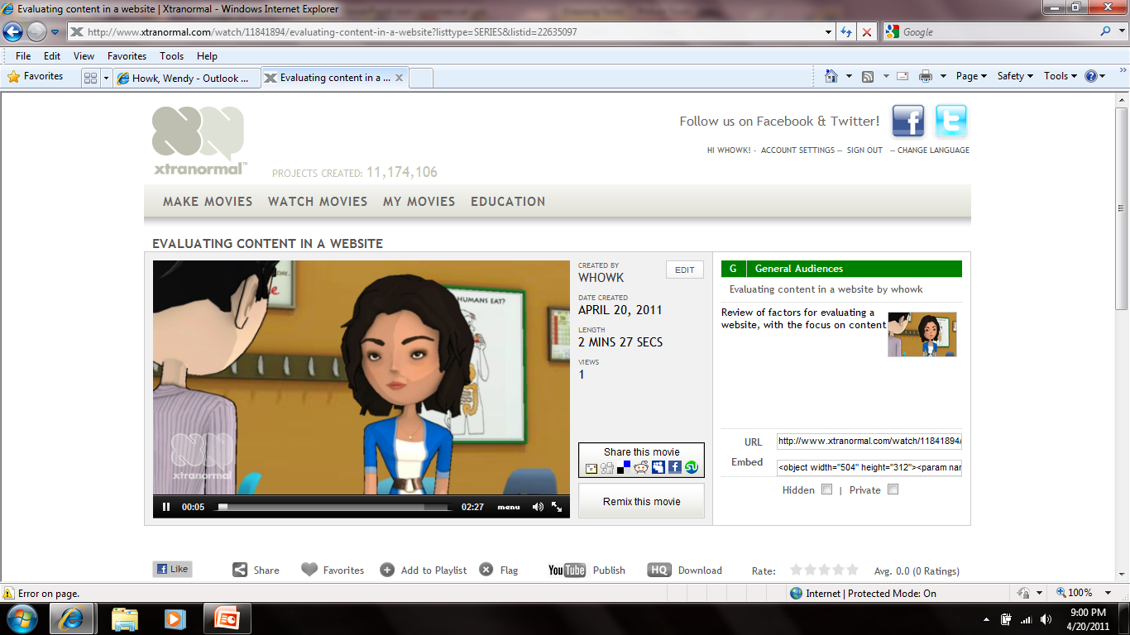
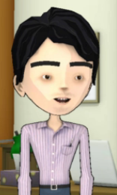
Do you trust….
Everything your friends tell you?
Everything you see on TV?
Everything you read in a book?
Everything you read in a text message?
Everything you read on the internet?
YES!
NO!
Click on the person you agree with most.

Slide 3
You’re Right!
Read on to see why you can’t trust everything you hear, read, or see…
Click here

Slide 4
Think again!
Read on to find out why you can’t trust everything you hear, read, or see…
Click here

Slide 5
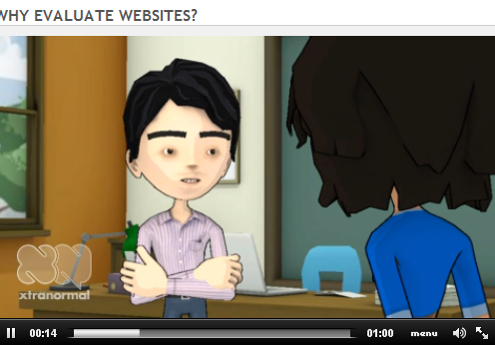
Click on the picture below to watch a quick video about why you need to evaluate.
          Click to enlarge
                Watch me! When you get to the video.
When you are finished, please X out of the video and you will return to this lesson.
Click here

Slide 6
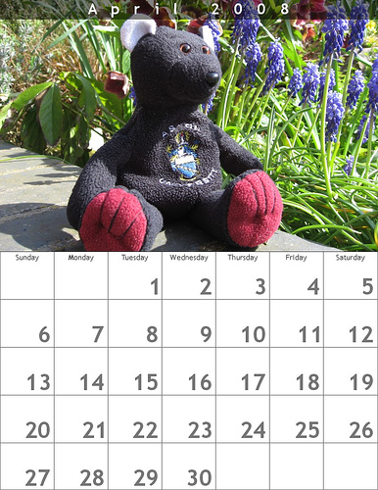
Click the pictures to Learn More about Evaluation Criteria…
WHEN?
WHERE?
Some rights reserved by Quite Adept
WHO?
WHAT?
WHY?
Click here to test your knowledge

Slide 7
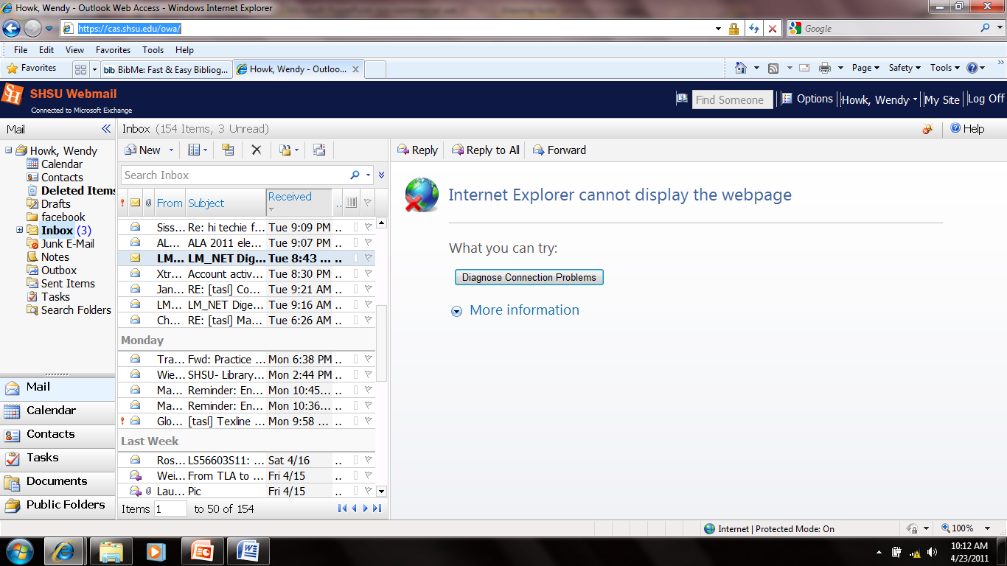
Where? = Domain
Where was this website created?
You can check out the Domain names. Look at the URL on the top
  Usually you can trust domains that have .edu or .gov but you still need to check the other W’s!
Domain | Purpose
.edu | Created by a school or university
.gov | Created by the government
.com/.biz | Usually created for commercial purposes (to sell things)
.org | Created by organizations, originally for nonprofit organizations or non-commercial groups
.net | A generic label – don’t not tell you anything about who created it
.mil | Created by the military
Click to go back to choices

Slide 8
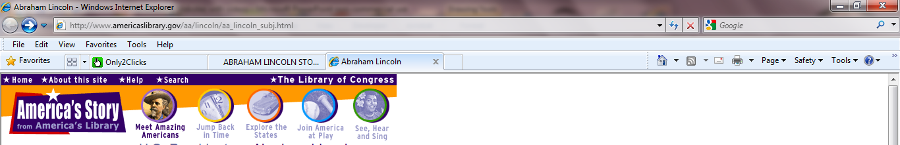
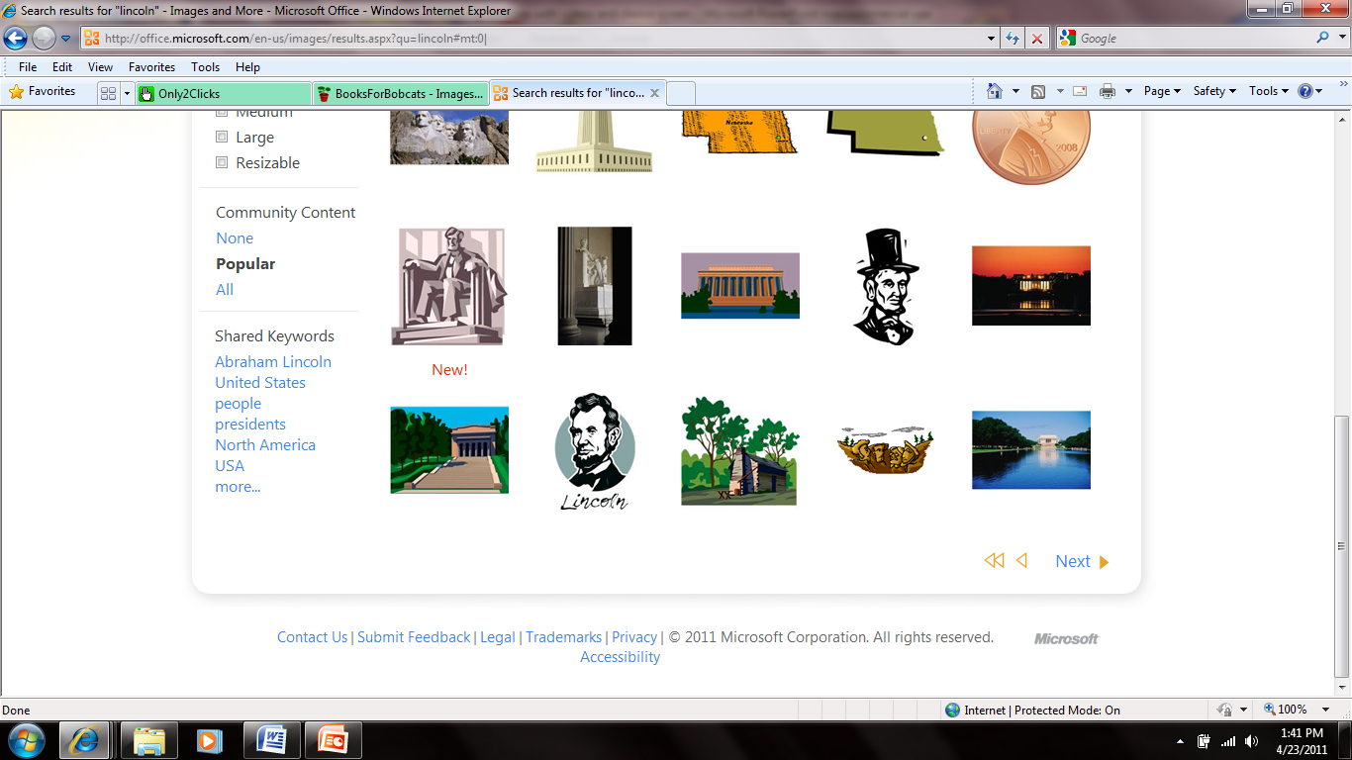
Who? = Authority
Who created this website?
Is this person or group an expert in what they are writing about?
Look at the very top or very bottom of the page.
    About this site.
    Contact us (you should have an email or mailing address to the website author)
    You might have to find the HOME page to find this information.
    Keep hunting – sometimes it’s hidden ☺
Click to go back to choices

Slide 9
Why? = Purpose
Are they trying to convince you that their opinion is the only way – this means the site has bias?
Why has this website been created?
Is someone trying to sell you something?
Are they providing information?
Bias is an unfair preference for or dislike of something
Click to go back to choices

Slide 10
What? = Content
    Click on the picture below to watch a video about what you should look for when evaluating the content.
Remember! You can click to enlarge the video to fill your screen.
X out and return to this PowerPoint when you are done.
Click to go back to choices

Slide 11
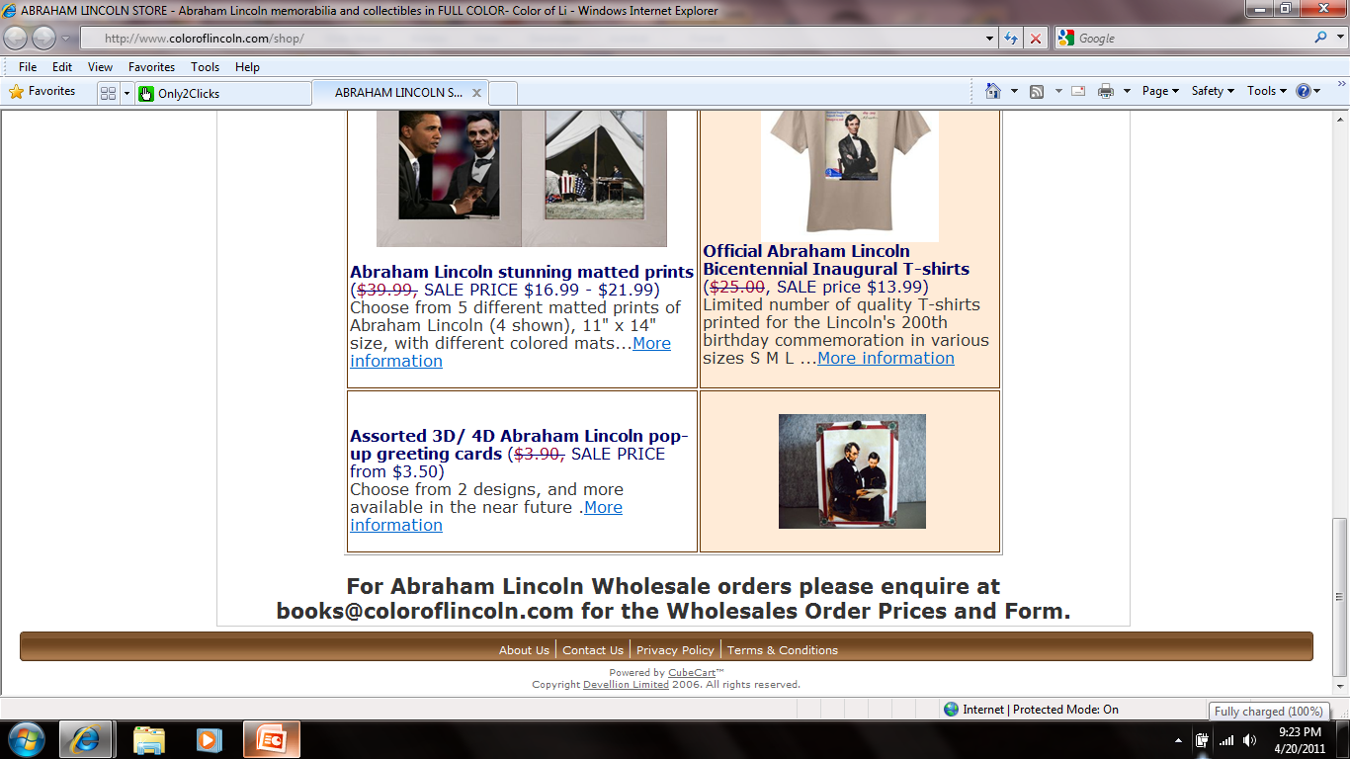
When? = Currency
When was this website created?
When was it last updated?
Click to go back to choices
Look at the bottom of the page to find your dates.

Slide 12
Your Turn…Do you remember the 5 W’s?
Open a Word document and record what you
have learned.
Print out this document and use it when you
evaluate the websites.
X out of the document after you have successfully
printed. (Do not save) Return to this PowerPoint.
Click here to begin.
Click here to continue

Slide 13
Click each picture below and use your web to help you evaluate each website about Abraham Lincoln.
These are resources you might use for the wax museum. You are looking for the best website possible!
You did it!

Slide 14
Use it….
Click here: http://www.americaslibrary.gov/aa/lincoln/aa_lincoln_subj.html Return here & make your evaluation below.
Great Website! It meets most or all of the criteria!
This website has some good information, but I will need other sources too.
This is not a good website to use for research.

Slide 15
You’re Right!
Who? Library of Congress
Where? Government
When? Not found
Why? Educating, sharing information
What? Timeline, dates, easy to read and navigate, includes links to other information, good level of text
Click here to return to choice screen.

Slide 16
Sorry
Try Again!
Click here to try again.

Slide 17
Use it….
Click here: http://www.chenowith.k12.or.us/tech/cgcc/projects/bright/lincoln01.htm
Great Website! It meets most or all of the criteria!
This website has some good information, but I will need other sources too.
This is not a good website to use for research.

Slide 18
You’re Right!
Who? Betty – Who’s Betty?
Where? K12 edu – a school, somewhere?
When? Not found
Why? Educating, sharing information
What? dates, easy to read and navigate, no references or citations
Click here to return to choice screen.

Slide 19
Sorry
Try Again!
Click here to try again.

Slide 20
Use it….
Click here: http://www.who2.com/abrahamlincoln.html
Great Website! It meets most or all of the criteria!
This website has some good information, but I will need other sources too.
This is not a good website to use for research.

Slide 21
You’re Right!
Who? Who2 staff – Who are they?
Where? .com
When? Current date at bottom
Why? Education, sharing information, but also includes many advertisements
What? Text level looks okay, links for more information, references
Click here to return to choice screen.

Slide 22
Sorry
Try Again!
Click here to try again.

Slide 23
Use it….
Click here: http://www.coloroflincoln.com/shop/
Great website! It meets most or all of the criteria!
This website has some good information, but I will need other sources too.
This is not a good website to use for research.

Slide 24
You’re Right!
Who? Abraham Lincoln store
Where? .com - it’s a store (com means commercial)
When? 2006
Why? Selling things
What? Does not include any research information
Click here to return to choice screen.

Slide 25
Sorry
Try Again!
Click here to try again.

Slide 26
Use it….
I think I’m getting the hang of this!
Click here: http://www.worldbookonline.com/kids/article?id=ar831512&st=lincoln
Great website! It meets most or all of the criteria!
This website has some good information, but I will need other sources too.
This is not a good website to use for research.

Slide 27
You’re Right!
Who? World Book Encyclopedia
Where? .com - it’s a commercial encyclopedia (the library pays for it)
When? 2011
Why? Providing information for research purposes
What? Easy to read, easy to navigate, includes links and citations, good level of text
Click here to return to choice screen.

Slide 28
Sorry
Try Again!
Click here to try again.

Slide 29
Great Job Evaluating!
You are now ready to use the internet to search for websites to help you research!
If you want to learn more about website evaluation visit….
A quick review
Try the evaluation wizard
Read more about it!
Click here for acknowledgements

Slide 30
Acknowledgements
Evaluation. (n.d.). Welcome to TEAMS educational resources. Retrieved
April 16, 2011, from http://teams.lacoe.edu/documentation.
Great Websites for Kids. (n.d.). American library association. Retrieved April 17, 2011, from www.ala.org/ala/mgrps/divs/alsc/greatwebsites/great websitesforkids/greatwebsites.cfm .
Joseph, L. (2000, May 15). The quality information checklist. Avon Public Schools - Home. Retrieved April 10, 2011, from http://www.avon.k12.ct.us/enrichment/Enrich/quickgr4-0.htm . Permission granted for use via email 4/14/2011.
K-5 evaluation rating sites lesson. (n.d.). Common sense media. Retrieved April 17, 2011, from www.commonsensemedia.org/sites/default/files/K- 5-Evaluation-RatingSites-Lesson.pdf.
Microsoft Office Clip Art. Retrieved April 23, 2011 from http://office.microsoft.com/en-us/images/results.aspx?qu=lincoln#mt:0|.
Shrock, K. (n.d.). Kathy Schrock's home page. Kathy Schrock's home page. Retrieved April 16, 2011, from http://kathyschrock.net.
Hit esc
To finish

